Slide 1
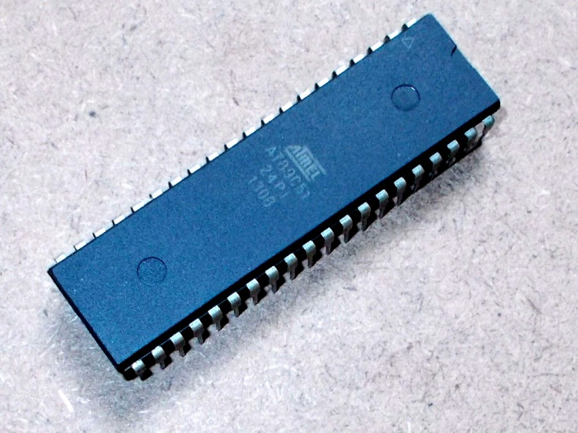
BIDIRECTIONAL VISITOR COUNTER USING MICROCONTROLLER
Under the guidance of Mrs. Saraswati Saha
Ranip Hore (ECE/2011/012)
Puja Pal (ECE/2011/020)
Birupam Metya (ECE/2011/047)
Presented by

Slide 2




Aim of the Project
This project titled “Microcontroller based Bidirectional Visitor counter” is designed and presented in order to count the visitors of an auditorium, hall, offices, malls, sports venue, etc.
The system counts both the entering and exiting visitor of the auditorium or hall or other place, where it is placed. Depending upon the interrupt from the sensors, the system identifies the entry and exit of the visitor.
On the successful implementation of the system, it displays the number of visitor present in the auditorium or hall. This system can be economically implemented in all the places where the visitors have to be counted and controlled.

Slide 3
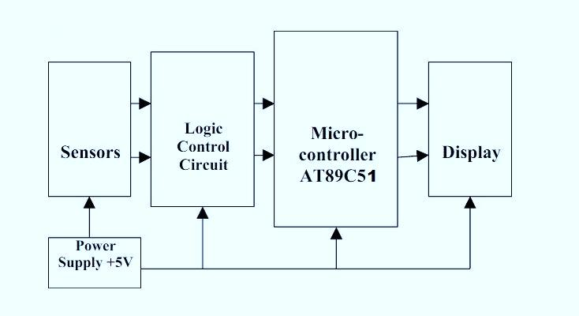
Block Diagram

Slide 4
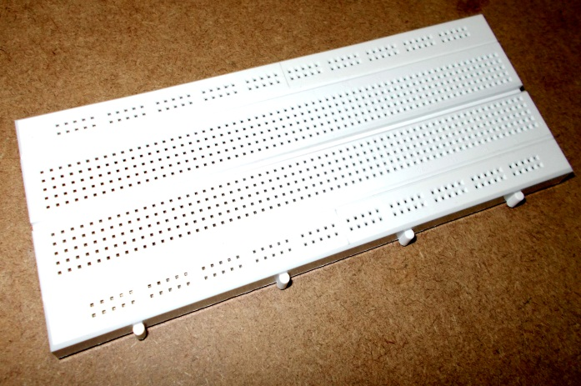
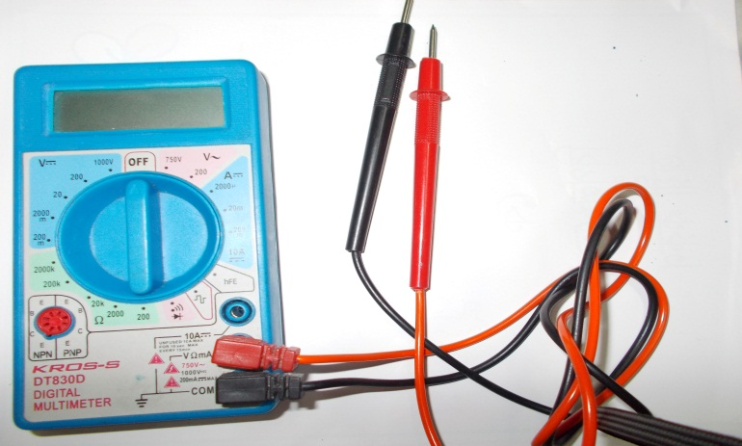
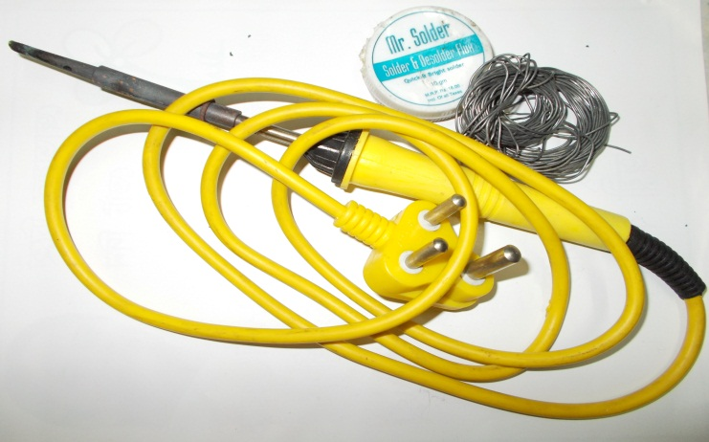
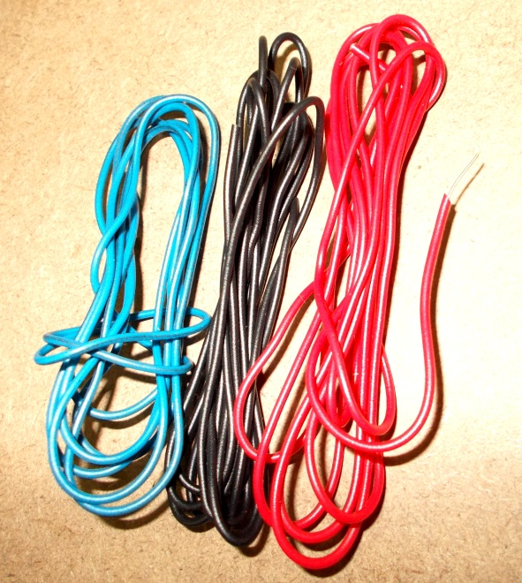
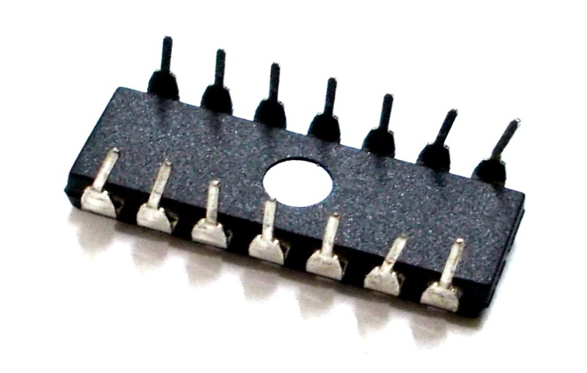

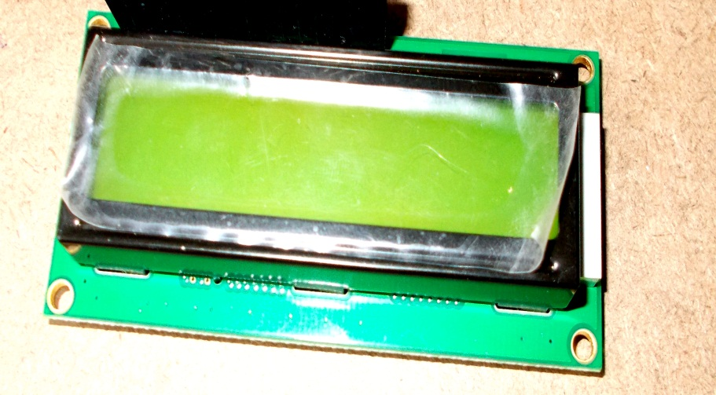
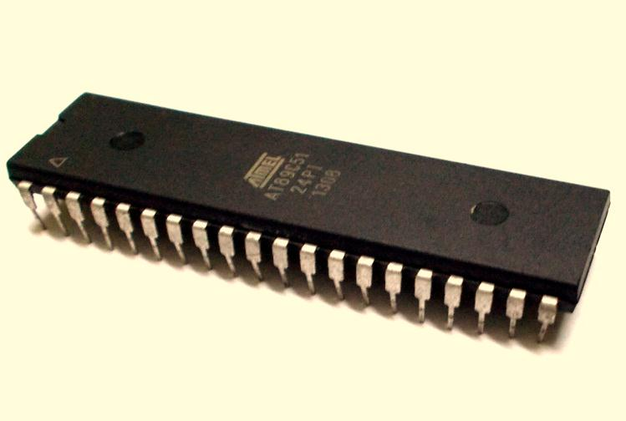
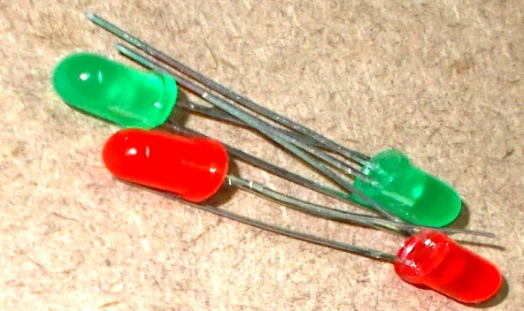
Materials Used(Slide 1)

Slide 5
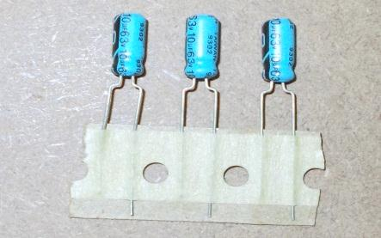
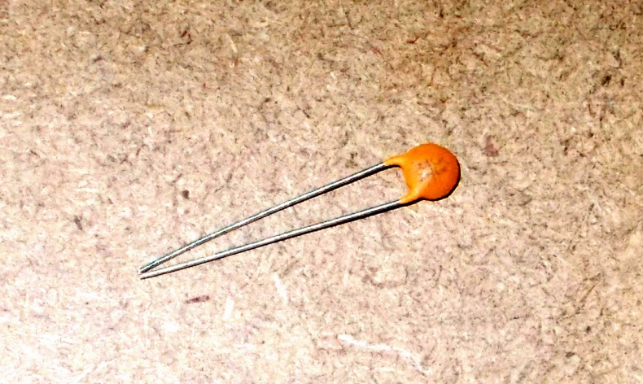
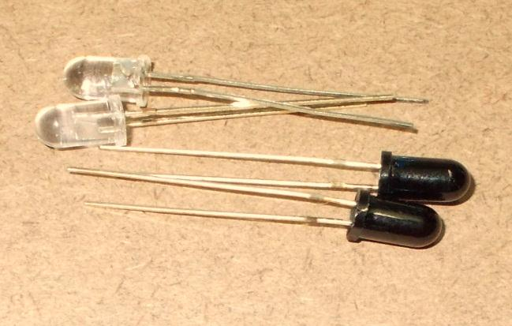
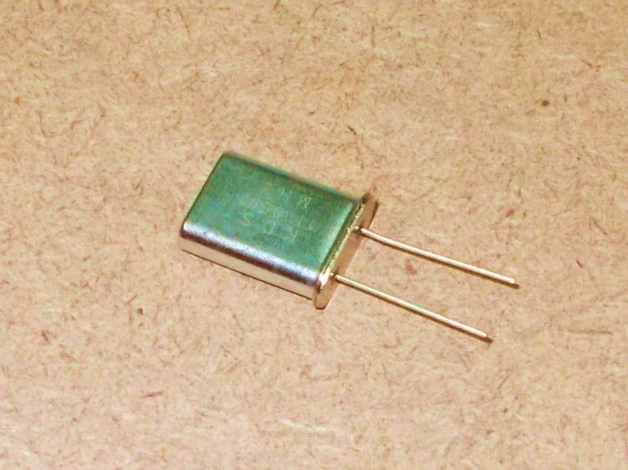
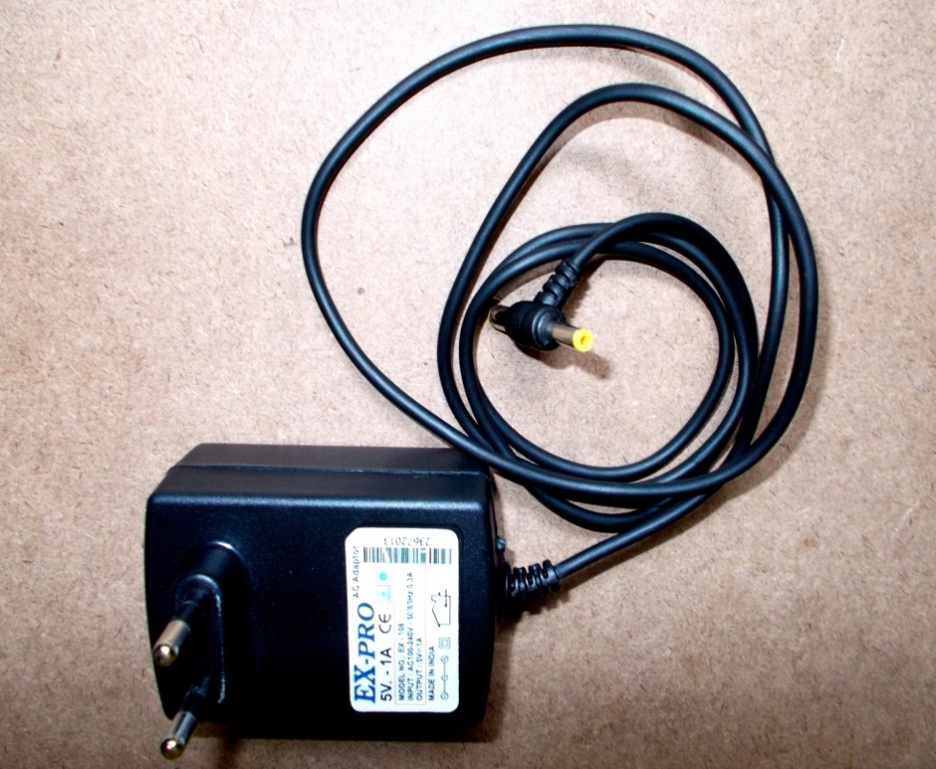
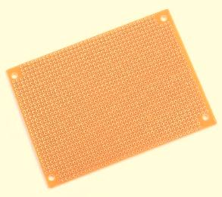
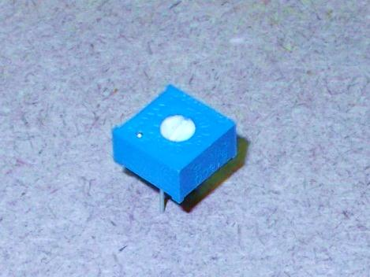
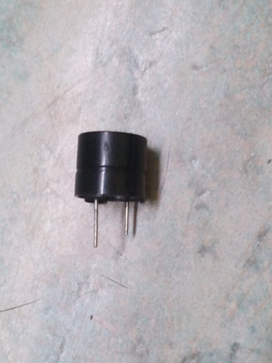
Materials Used(Slide 2)

Slide 6
Different Sections of the project
Sensor
Display
Counter
Notes:
Different sections of the project

Slide 7
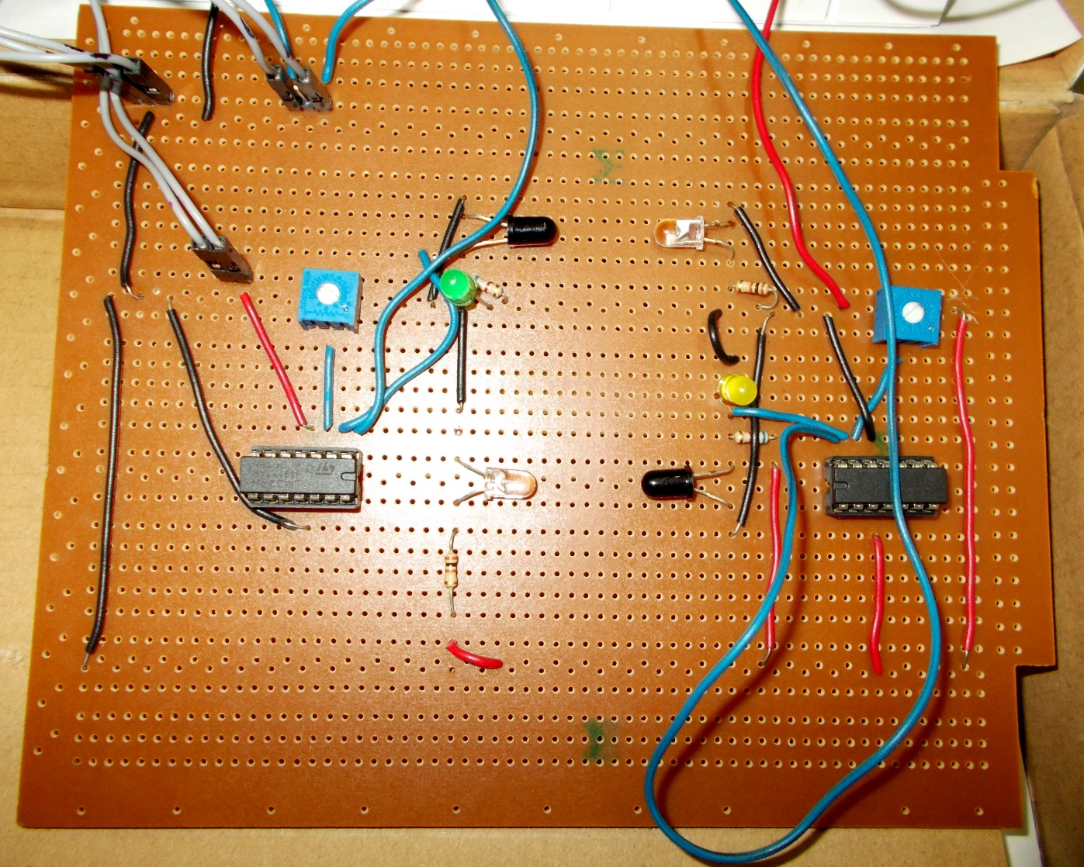
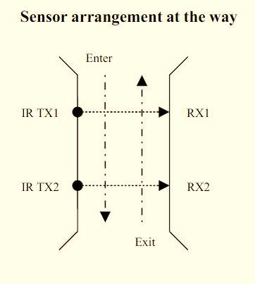
Sensor
A pair of IR Transmitter and Receiver is used at the entry-cum-exit gate. Whenever a person passes through the gate there is an interruption in IR beam and a clock pulse is generated for the microcontroller.

Slide 8
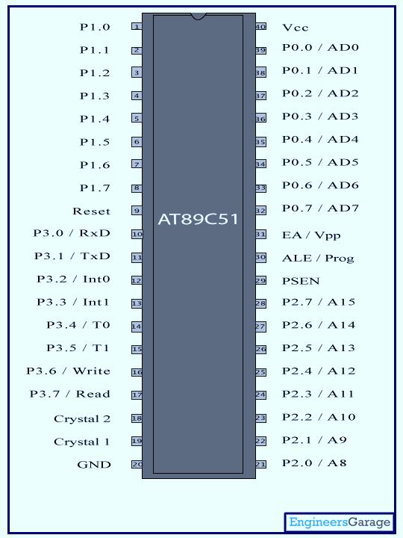
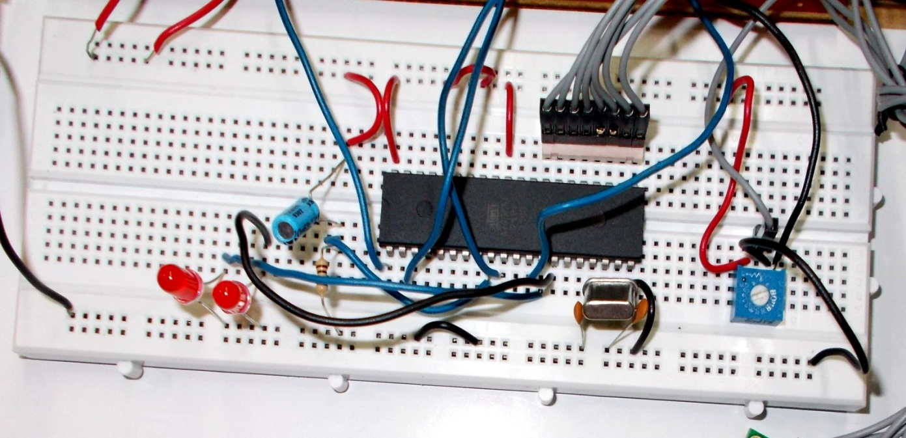
Counter
The microcontroller controls counting and displays the number of persons present inside the hall.
The outputs of the Op-amps are fed to pin P1.0 and P1.1 of the 8-bit microcontroller AT89C51.
The microcontroller is programmed in such a way that when it will sense low signal at P1.0 it will increment the count by 1 and when it will sense a low signal at P1.1 it will decrement the count by 1.
The AT89C51 is a 8-bit microcontroller with 4 KB of flash based program memory,128 bytes of RAM, 32 input/output lines, two 16 bits timers/counters, on-chip oscillator and clock circuitry.

Slide 9
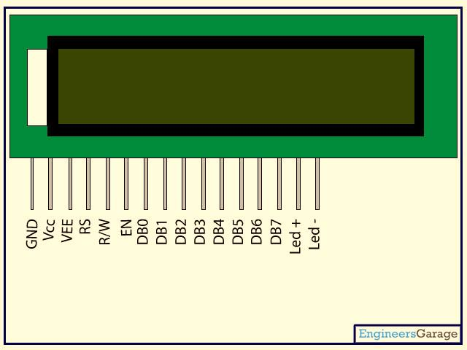
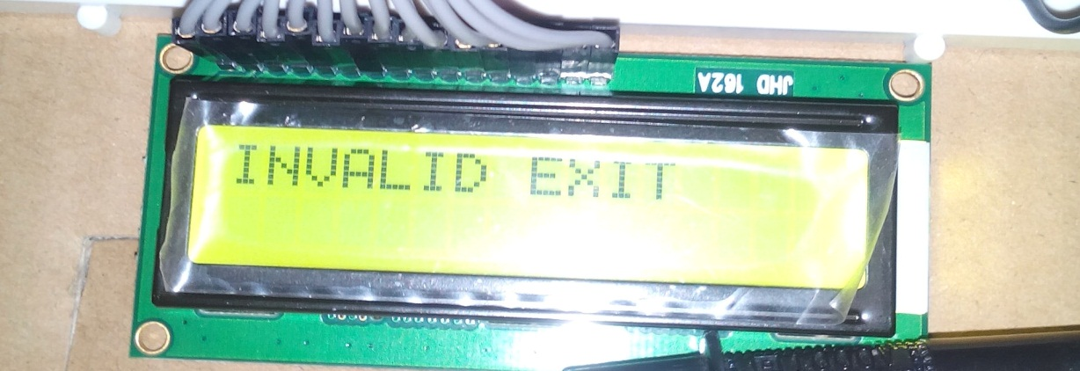
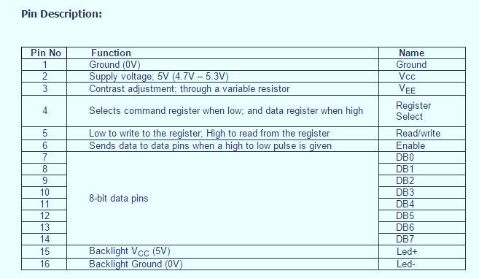
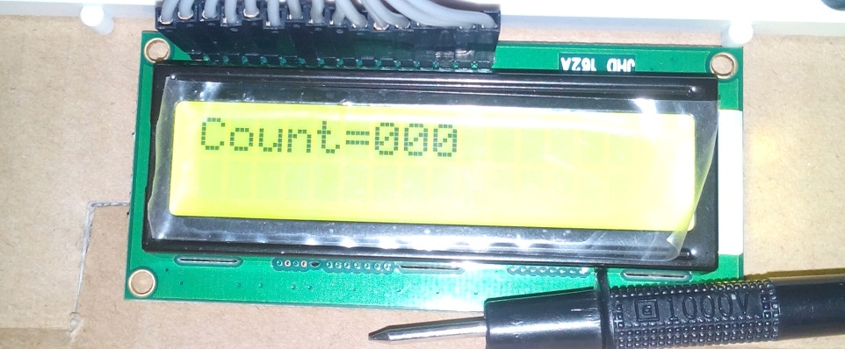
Display
The count is displayed on a 16x2 LCD through the data sent through port 2 which is configured as an output port.

Slide 10
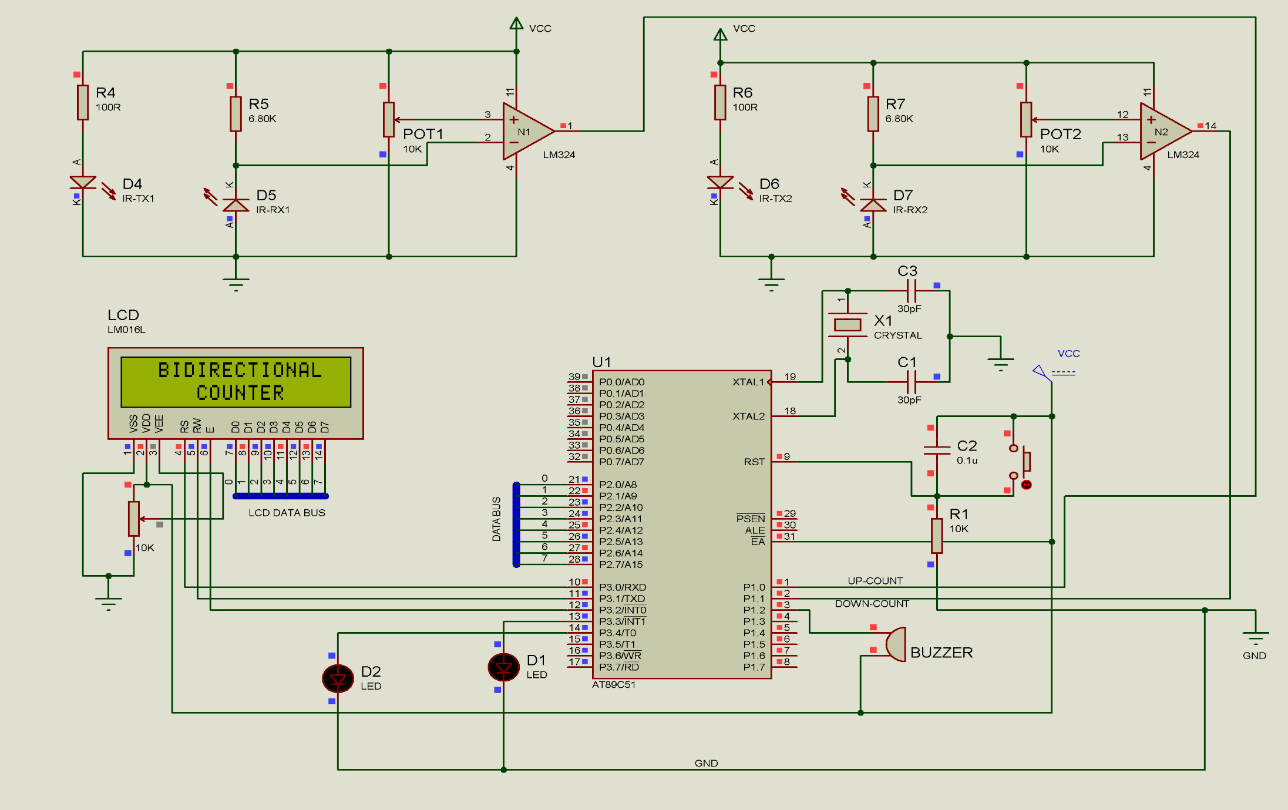
Circuit diagram
When the IR beam is not interrupted
When the IR beam is interrupted
0.1v
4.24v
0.01v
0.07v
1.82v
ENTRY
EXIT
LED indicating the delay of 100 ms
LED indicating invalid
exit
Whenever an invalid exit is detected

Slide 11
Algorithm
Step 1: Start the process
Step 2: Select port 2 as output port for displaying the count value in LCD.
Step 3: When a low signal is sensed at P1.0, increment the count by 1.
Step 4: When a low signal is sensed at P1.1, decrement the count by 1.
Step 5: Continue the process, whenever a low pulse is sensed at pin P1.0 and pin P1.1.

Slide 12
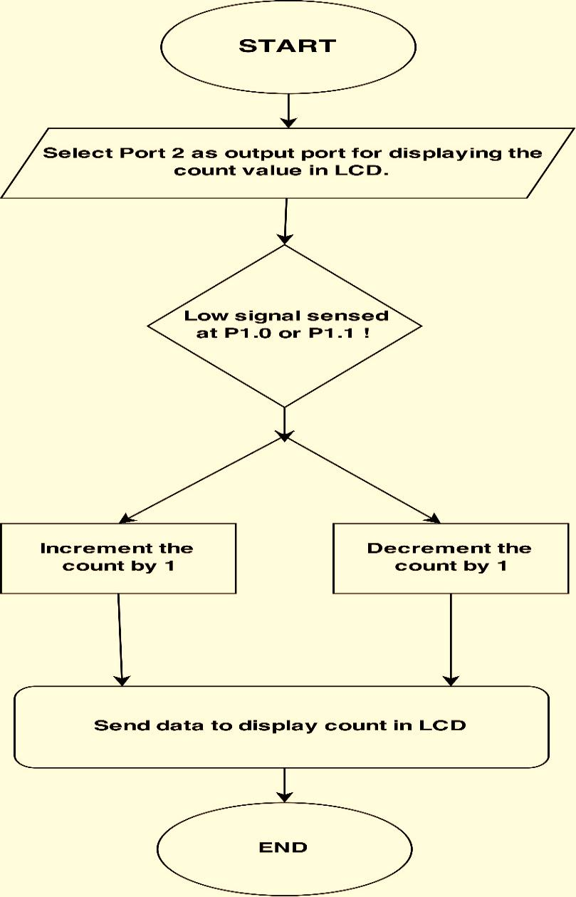
Flow chart

Slide 13
Output
WHEN THE IR BEAM IS NOT INTERRUPTED
Voltage across IR Transmitter | 1.32 volts
Voltage across IR Receiver | 0.07 volts
Voltage at the non-inverting terminal of Op-amp(Fixed reference voltage) | 0.1 volts
Voltage at the inverting terminal of Op-amp(i.e. Voltage across IR Receiver) | 0.07 volts
Output voltage of Op-amp | 4.24 volts(Logic 1)
WHEN THE IR BEAM IS INTERRUPTED
Voltage across IR Transmitter | 1.32 volts
Voltage across IR Receiver | 1.82 volts
Voltage at the non-inverting terminal of Op-amp(Fixed reference voltage) | 0.1 volts
Voltage at the inverting terminal of Op-amp(i.e. Voltage across IR Receiver) | 1.82 volts
Output voltage of Op-amp | 0.01 volts(Logic 0)
MICROCONTROLLER
Logic low | 0.03 volts
Logic High | 4.13 volts
VCC | GROUND
6.08 volts | 0 volts

Slide 14

Conclusion
Thus the project entitled “Bidirectional Visitor Counter” helps to measure the visitor entering and exiting a particular passage or way.
The circuit counts both entering and exiting visitors and displays the number of visitors present inside the hall.
The circuit may also be enhanced with a wide counting range of above three digits by modifying software section of the system.
It can also be enhanced for long and accurate sensing range using a laser torch instead of IR transmission circuit.
Thus the circuit can be used to monitor visitor flow in effective manner, where the visitors have to counted and controlled.

